Slide 1
Furniture store Sales & Inventory Optimization
Presentation
By
Seshi Reddy Syamala

Slide 2

Agenda
Introduction
Business Problems
Challenges
Recommendations

Slide 3
Introduction
What is This About?
The company is a furniture retailer, specializing in a wide range of home and office furniture including chairs, tables, bookcases, and furnishings.
Operating across multiple regions in the United States, the business aims to provide quality products to a diverse customer base.
Despite steady sales growth, the company faces profitability challenges due to inefficiencies in discounting, regional performance, and inventory management.
Objective
Goal: Analyze the company’s sales and profit trends to identify and solve key business challenges.
Focus: Use data insights to enhance profitability and streamline inventory operations through actionable solutions.

Slide 4
The Story So Far
What are we trying to solve?
Key Business Questions:
Which product categories/sub-categories are losing money despite high sales?
How are discounts affecting profitability?
Are we managing inventory efficiently to avoid overstocking or stockouts?
Which regions need better focus for profitability improvement?
How can future trends guide strategic decisions?

Slide 5
Decision-Making Framework
Methods Used:
Data Analysis:
Cleaned and explored the dataset.
Filtered relevant fields (e.g., Region, Sub-Category).
Visual Analytics:
Created visualizations for trends, patterns, and outliers.
Forecasting:
Used Tableau to predict future sales and inventory needs.
Calculated Fields:
Added key metrics like Sales-to-Profit Ratio and Safety Stock.

Slide 6
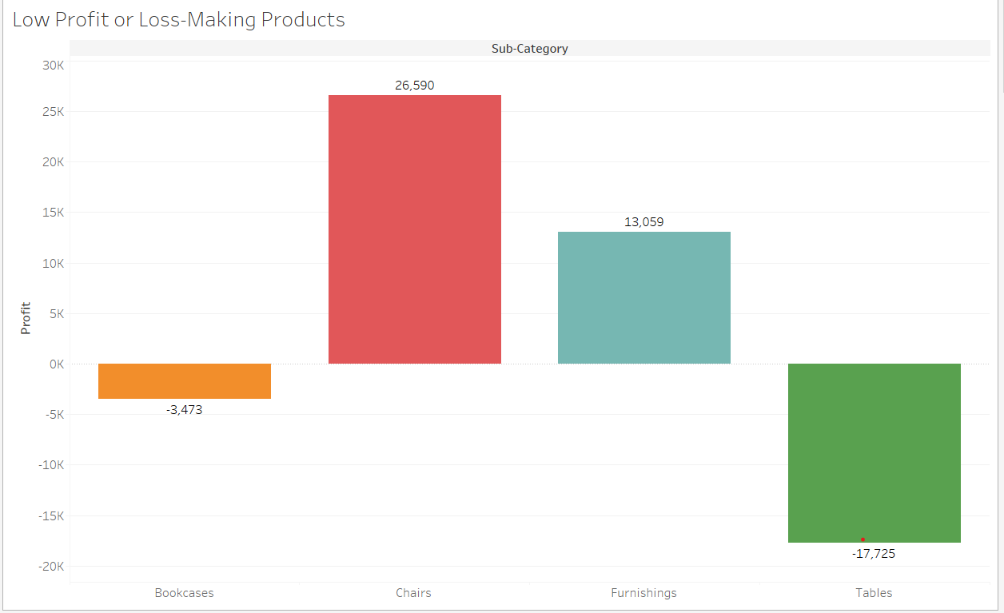
Challenge #1: Low Profit in Sub-Categories
Story:
Bookcases and Tables are generating losses despite contributing to sales. Chairs, on the other hand, show consistent profitability. We need to investigate the reasons behind this disparity.
Actionable Insight:
Review pricing and discounting strategies for unprofitable sub-categories.

Slide 7
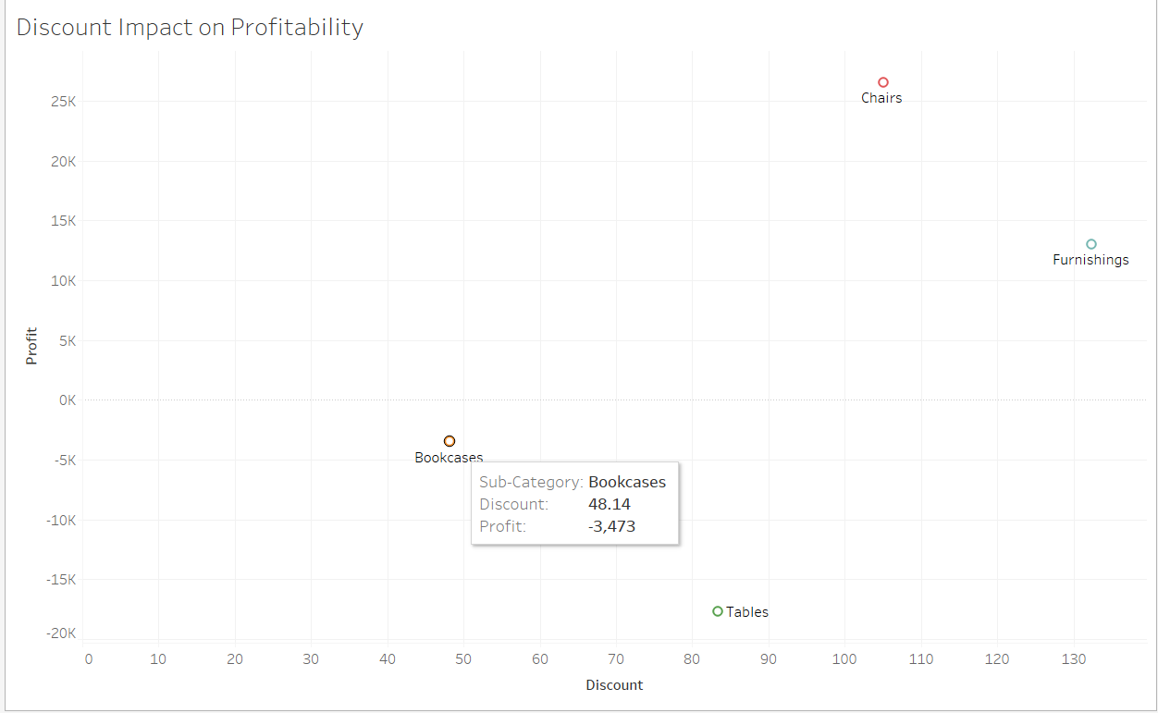
Challenge #2: Discounts Eroding Profits
Story:
The scatterplot shows that excessive discounts are directly linked to negative profits for products like Bookcases and Tables.
Actionable Insight:
Set discount thresholds to prevent over-discounting while maintaining sales momentum.

Slide 8
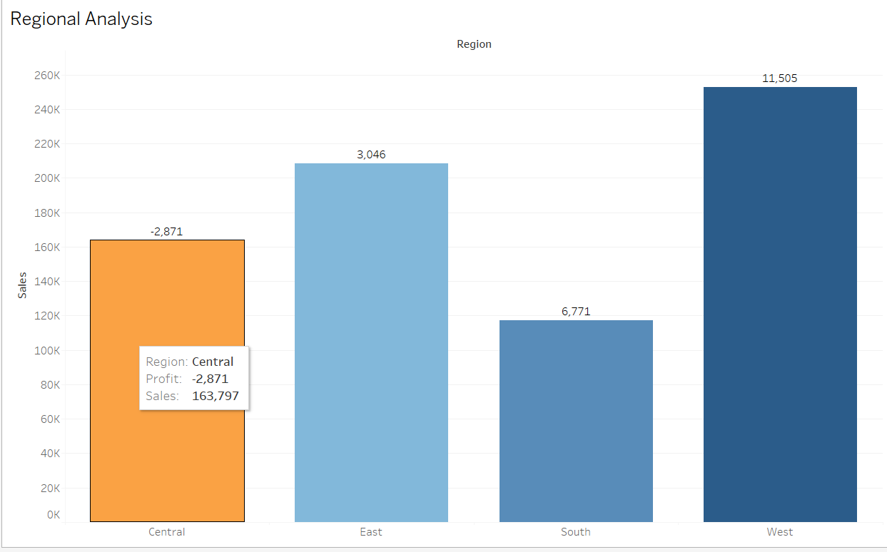
Challenge #3: Regional Performance
Story:
“The West region drives the highest profitability, while the South region lags despite moderate sales.
Actionable Insight:
Focus on improving operations in the South and leverage the success of the West region for other areas.

Slide 9
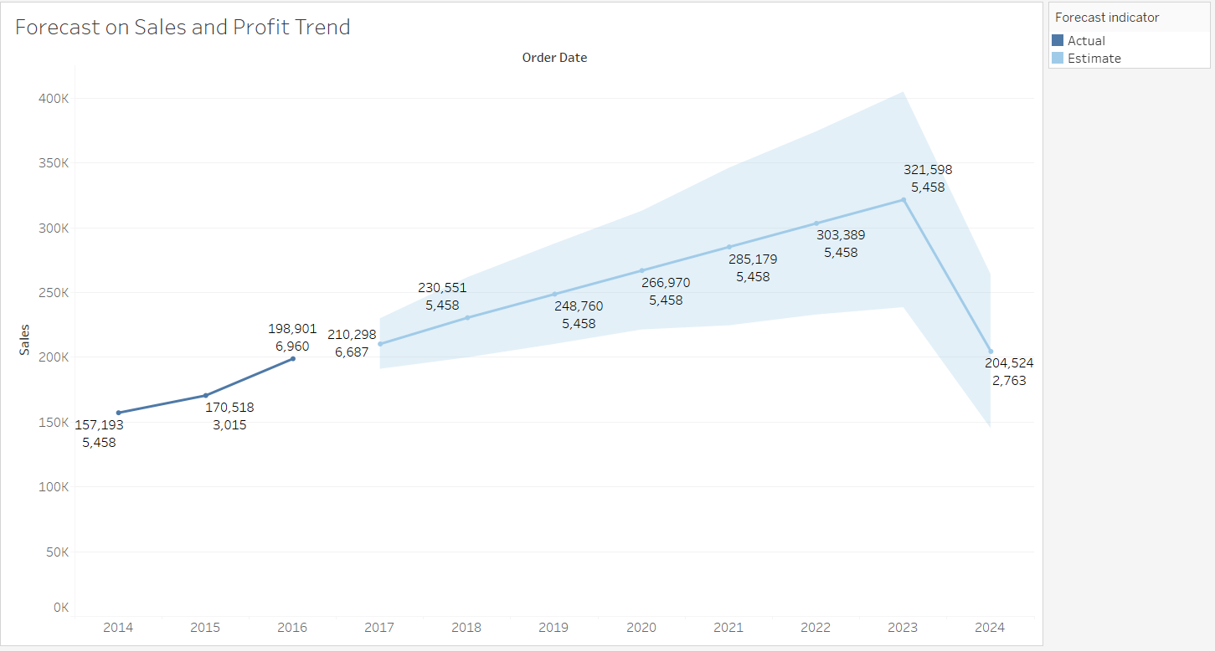
Challenge #4: Sales and profit Trends Over Time
Story:
Sales have steadily increased over the years, indicating business growth. However, this growth is not reflected in profitability trends.
Actionable Insight:
Align profit-focused strategies with sales growth to ensure sustainable expansion.
Use forecasted trends to anticipate challenges and align operational budgets.

Slide 10
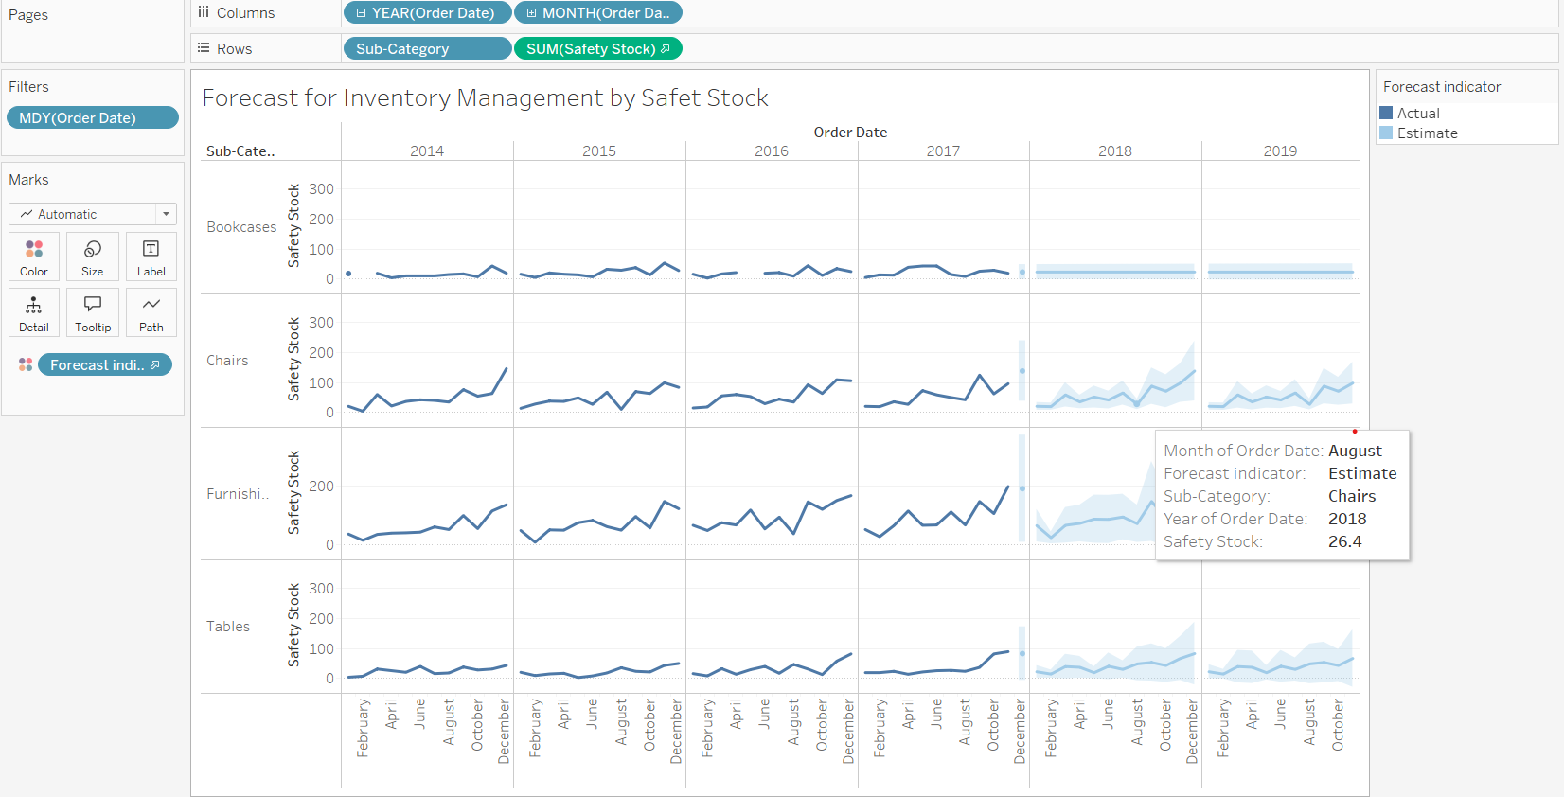
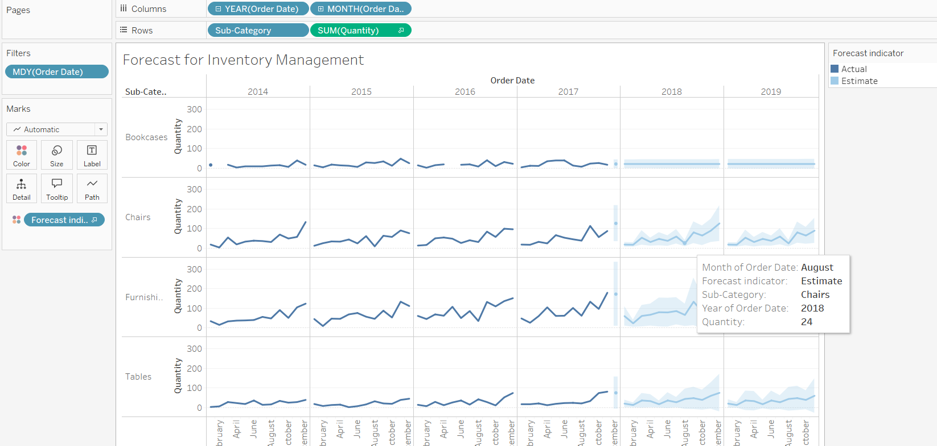
Challenge #5: Inventory Management
Story:
Forecasting reveals patterns in inventory demand. For example, Chairs have a steadily increasing demand, while Tables show more variability.
Actionable Insight:
Implement forecast-driven inventory management to reduce overstocking and stockouts.
Set safety stock levels for high-demand or volatile sub-categories like Tables.

Slide 11
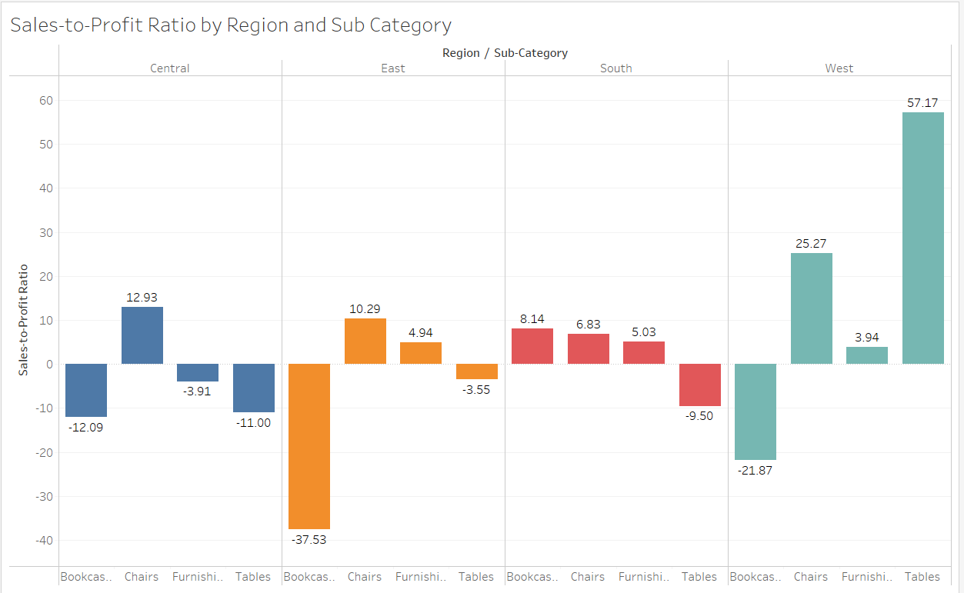
Challenge #6: Sales-to-Profit Ratio
Story:
The West region outshines others with a strong sales-to-profit ratio for Tables, while Bookcases underperform across all regions.
Actionable Insight:
Focus marketing efforts on profitable combinations like Tables in the West and reassess unprofitable segments.

Slide 12
Recommendations
Discount Optimization: Limit discounts on low-margin products and prioritize profitable items.
Forecasting for Inventory: Align inventory levels with demand trends and add safety stock for fluctuating items.
Regional Focus: Implement successful strategies from the West region in underperforming regions.
Product Strategy: Focus on high-margin sub-categories like Chairs and reassess low-profit items.

Slide 13
Conclusion
Discount optimization and regional focus are critical to sustained success.
Sales growth is strong, but profitability needs improvement.
Forecasting and data-driven inventory management can reduce operational inefficiencies.

Slide 14
Thank you

